Slide 1
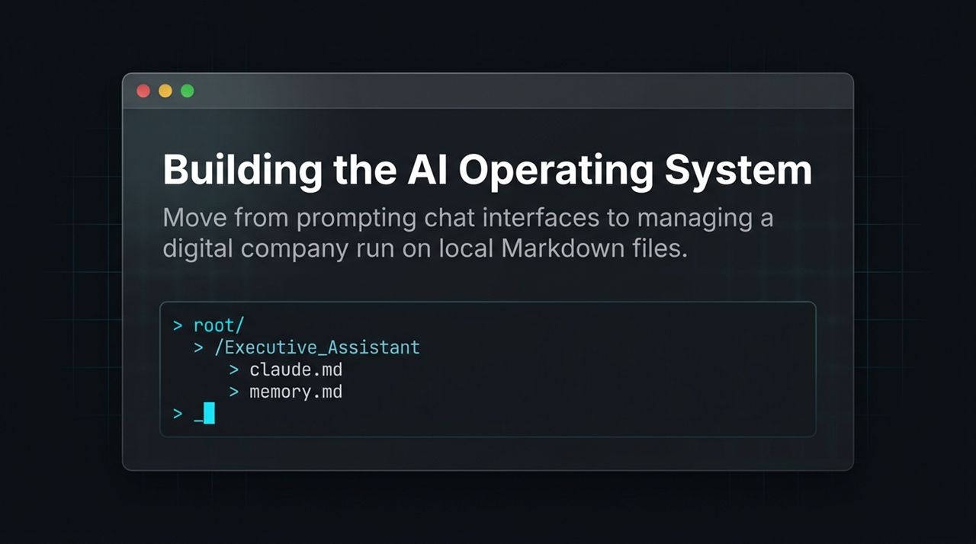
Notes:
Introduction: Welcome, everyone. Today, we're discussing a foundational shift in how we interact with artificial intelligence. Most people are still stuck in the chat interface paradigm—constantly re-prompting ChatGPT or Claude for every individual task. Today, we're transitioning from being prompt engineers to managing a digital company run on local Markdown files.
Core Concept: Look at the directory structure on the slide. This isn't just code; this is the blueprint for an AI Operating System. By using local files like claude.md and memory.md, we create persistent, context-aware AI employees that sit on our local machines rather than ephemeral chat windows.
Takeaway: By the end of this presentation, you will understand how to build and operate your own autonomous AI team using simple Markdown infrastructure.
https://www.youtube.com/watch?v=eA9Zf2-qYYM

Slide 2
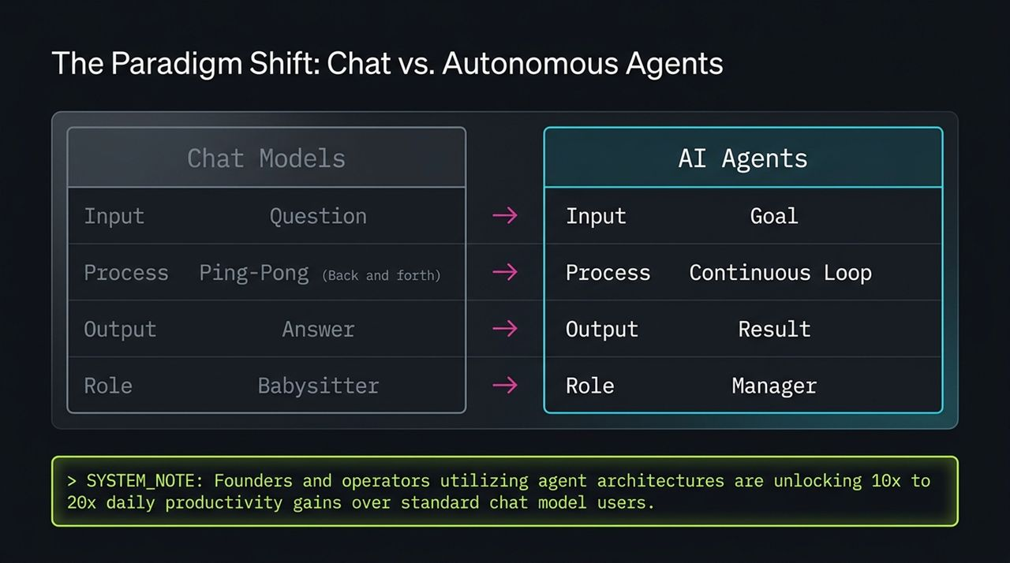
Notes:
The Comparison: To understand why this system is so powerful, let's contrast traditional Chat Models with Autonomous AI Agents.
Input: With chat, you provide a single question. With agents, you provide a high-level goal.
Process: Chat is a ping-pong conversation—you speak, it replies, you correct. An agent runs a continuous, autonomous execution loop.
Output: Chat gives an answer; agents deliver an end-to-end result.
Role: In chat, you act as a babysitter. With agents, you step into the role of a manager.
Business Impact: Founders and operators leveraging agent architectures aren't just saving minutes—they are experiencing 10x to 20x daily productivity gains over standard chat interface users.

Slide 3
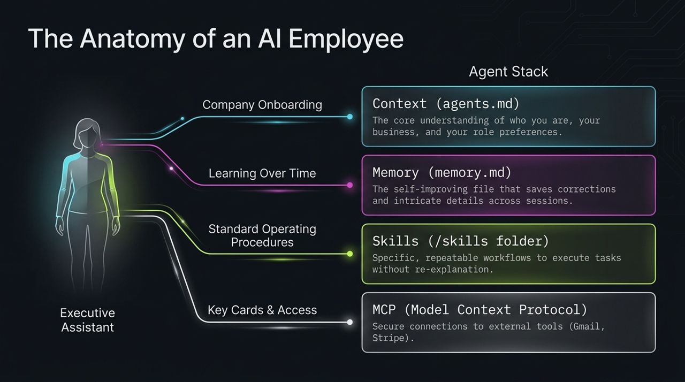
Notes:
Analogy: Think of an AI Agent like onboarding a real human executive assistant to your company. A human needs four things to succeed, and our Markdown stack mirrors these exact four layers:
Company Onboarding (agents.md): This provides the core context—who you are, what your business does, and how you like to work.
Learning Over Time (memory.md): Human employees learn from mistakes. This self-improving file logs corrections and specific preferences over time so you never repeat instructions.
Standard Operating Procedures (/skills folder): Every repeatable workflow or SOP is saved here as a Markdown file.
Key Cards & Access (MCP - Model Context Protocol): Secure bridge connections allowing the agent to read your Gmail, inspect Stripe, or manage Notion.

Slide 4
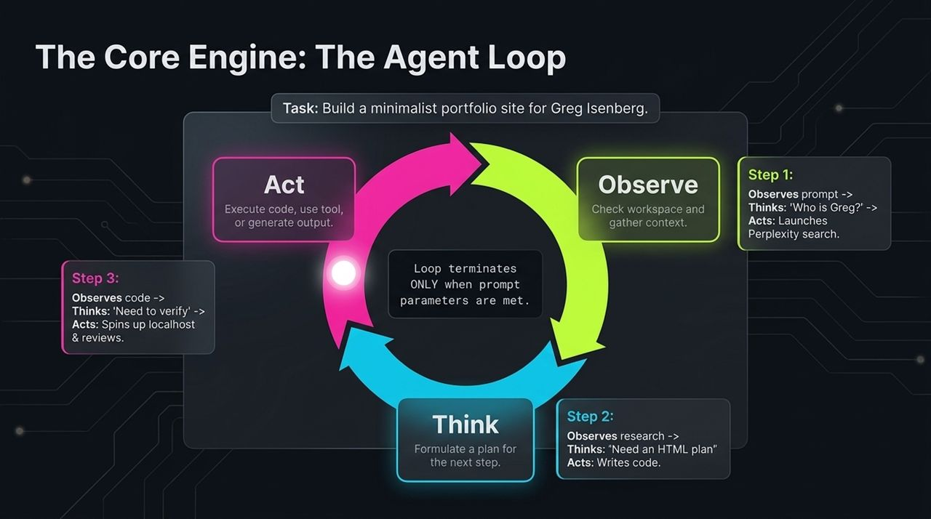
Notes:
The Loop Mechanics: How does an agent actually operate without human hand-holding? It uses the Observe-Think-Act loop.
Observe: The agent checks its environment and gathers data.
Think: It formulates a plan for the next logical step.
Act: It executes code, calls a tool, or updates a workspace.
Walkthrough Example: Consider building a portfolio site for Greg Isenberg:
Step 1: Observes prompt $→$Thinks 'Who is Greg?' $→$Acts by searching Perplexity.
Step 2: Observes research $→$Thinks 'I need HTML structure' $→$Acts by writing the code.
Step 3: Observes code $→$Thinks 'I must verify this' $→$Acts by launching localhost to review visually.
Key Insight: The loop terminates ONLY when the prompt parameters and quality criteria are met.

Slide 5
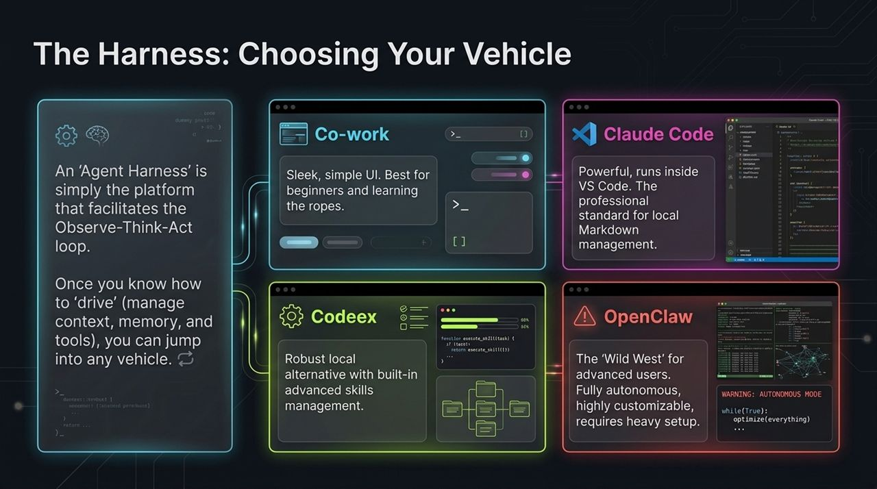
Notes:
Summary Review: To wrap up, let's review the shift:
Framework: We move from chat ping-pong to goal-oriented Observe-Think-Act loops.
Context: We replace long prompt typing with persistent system files (agents.md, memory.md).
Tooling: MCP connects our local Markdown OS to enterprise tools.
Final Call to Action: Start simple: set up your root folder, create your first claude.md context file, log your preferences in memory.md, and turn your first workflow into a reusable skill.

Slide 6
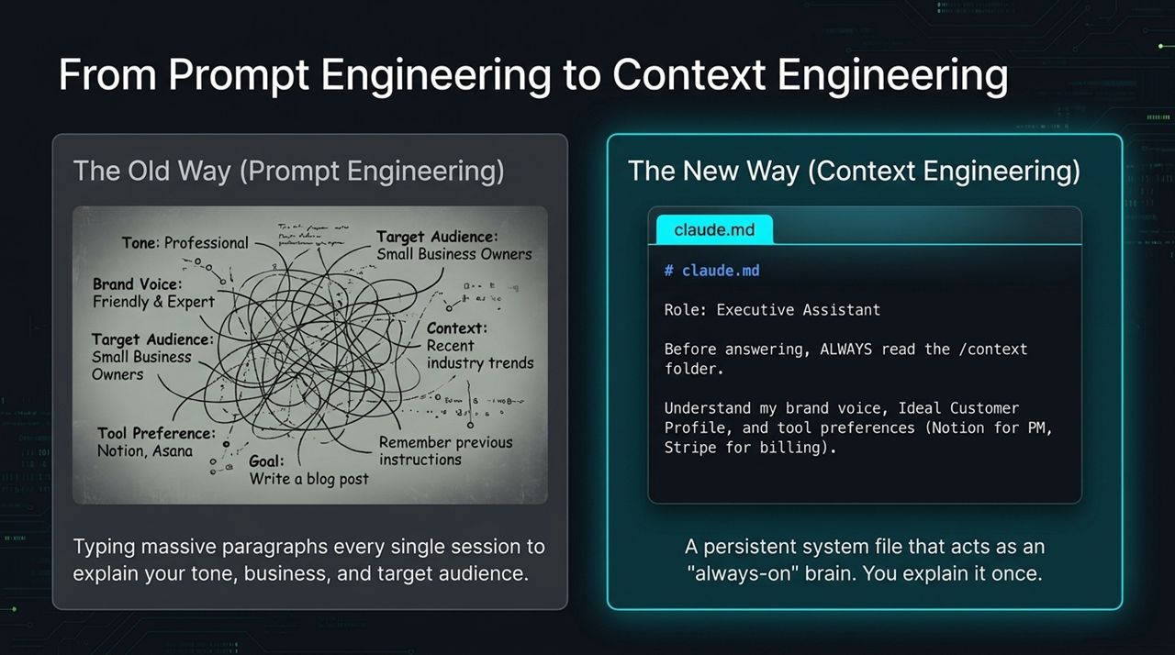
Notes:
The Old Way: Prompt engineering forced us to paste massive paragraphs explaining tone, brand voice, target audience, and constraints into every single chat window session.
The New Way: Context Engineering eliminates prompt bloat. By using a system file like claude.md, you set up a persistent, always-on brain.
Execution: In claude.md, you instruct the model: 'Role: Executive Assistant. Before answering, ALWAYS read the /context folder.' You explain your preferences once, and it persists permanently.

Slide 7
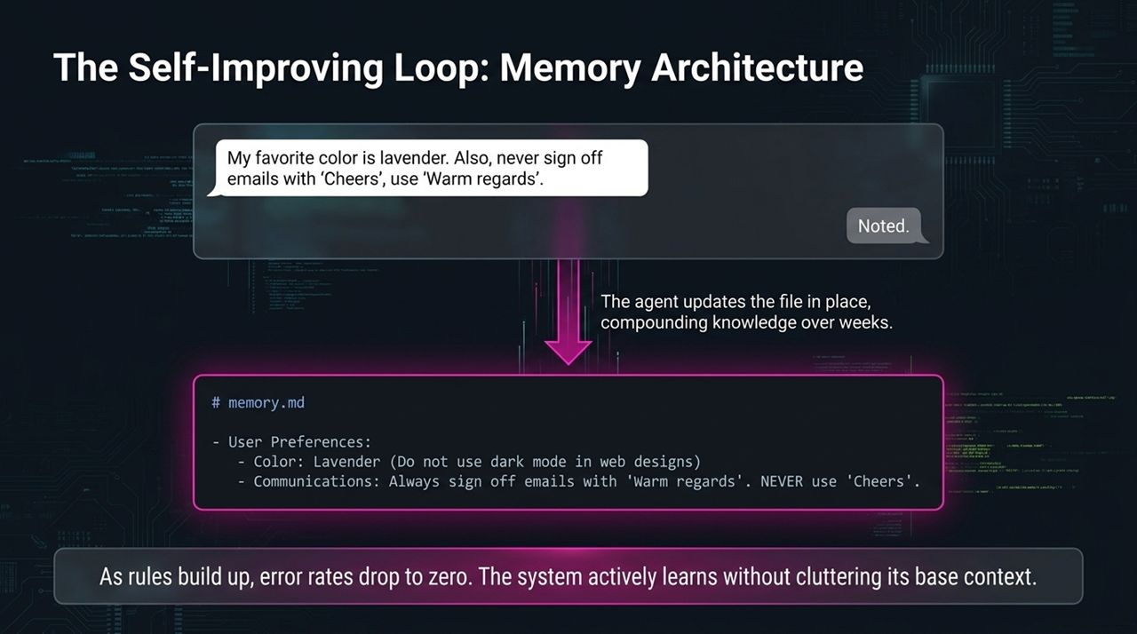
Notes:
Dynamic Learning: Most LLMs have complete amnesia between sessions. The memory.md file solves this by serving as a self-improving ledger.
How it Works: When you correct the AI—say, 'Never sign off emails with Cheers, use Warm regards'—the agent dynamically updates memory.md in real-time.
Compounding Effect: As these rules compound over weeks, error rates drop toward zero. The system actively learns without cluttering its base prompt context.

Slide 8
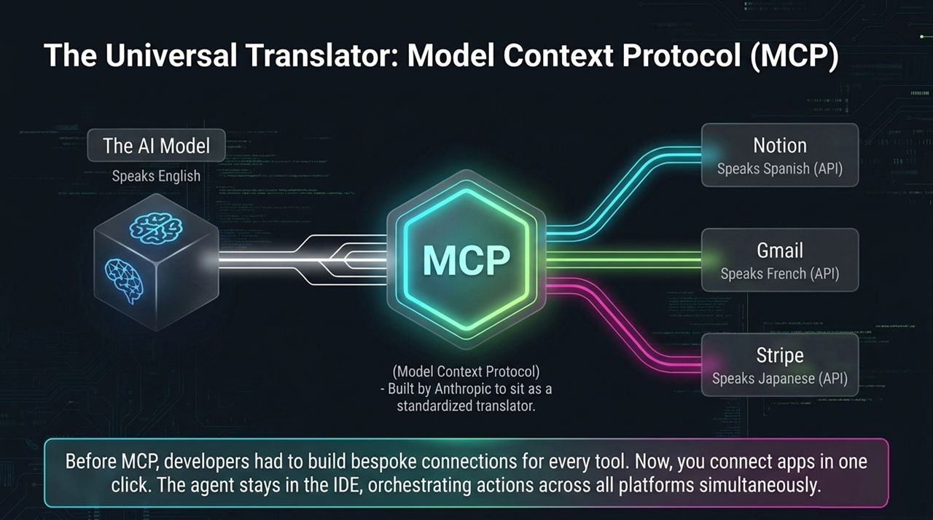
Notes:
The Integration Problem: Historically, connecting AI to outside tools required writing bespoke API connections for every platform.
The Solution: Model Context Protocol (MCP), developed by Anthropic, acts as a standardized universal translator. The AI model speaks English, while external apps speak their respective APIs.
Operational Value: MCP sits in the middle. With one click, your local agent in your IDE can read Notion docs, send Gmails, or pull Stripe billing data simultaneously.

Slide 9
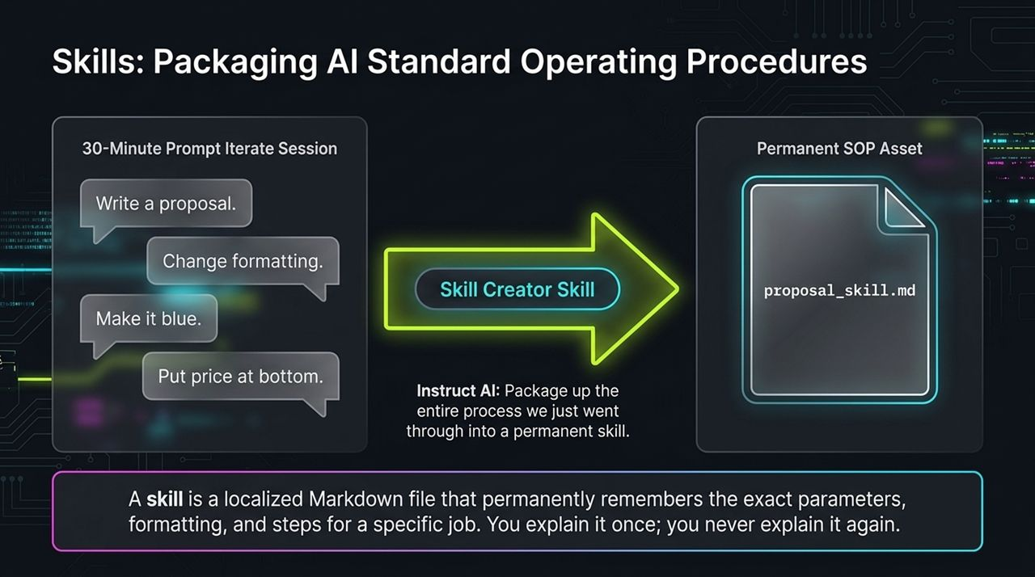
Notes:
Concept: A 'Skill' is a localized Markdown file that permanently remembers the exact parameters, formatting, and steps required for a specific job.
Creation Process: Imagine spending 30 minutes tweaking a sales proposal prompt—adjusting colors, formatting, and layout. Instead of losing that work, you invoke the Skill Creator Skill: 'Package up the entire process we just went through into a permanent skill.'
Result: It outputs proposal_skill.md. Moving forward, you simply invoke that file to execute complex, multi-step tasks perfectly.

Slide 10
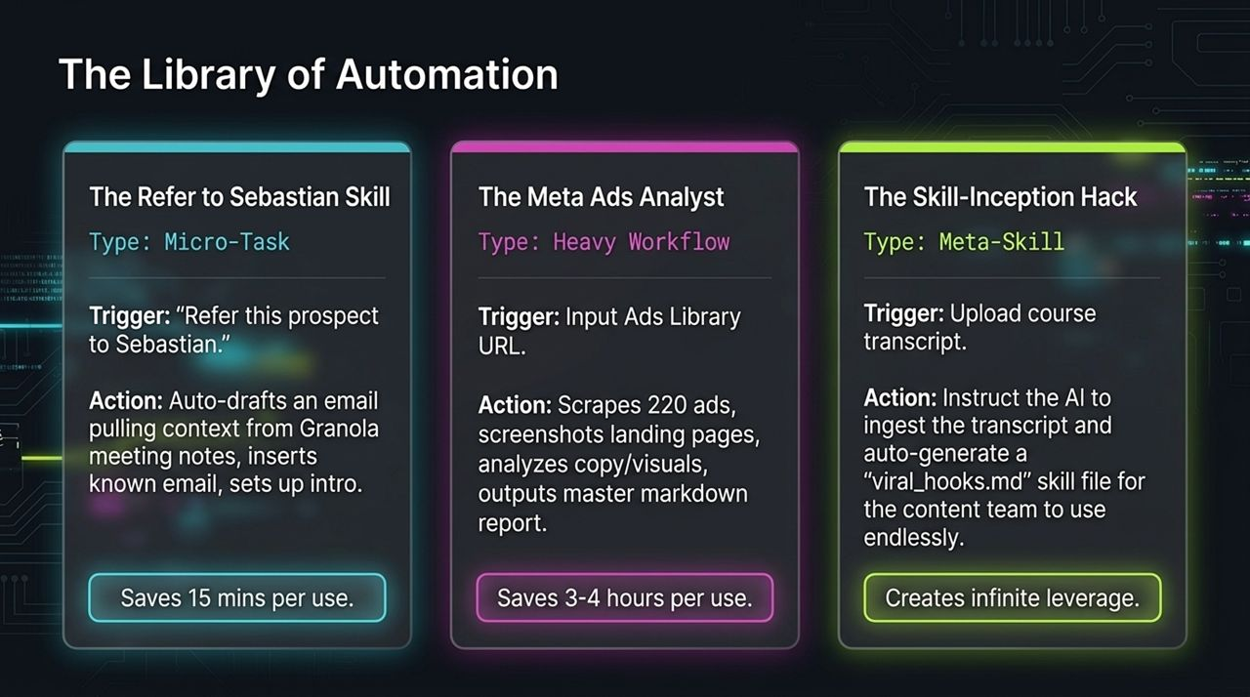
Notes:
Examples of Skills in Action:
Micro-Task (Referral Skill): Triggered by 'Refer prospect to Sebastian', it drafts an intro email pulling context from Granola meeting notes. Saves 15 minutes per use.
Heavy Workflow (Meta Ads Analyst): Input an Ads Library URL, and the agent scrapes 200+ ads, screenshots landing pages, analyzes visual/copy trends, and outputs a master Markdown report. Saves 3 to 4 hours per use.
The Skill-Inception Hack: Feed a course transcript to the AI and instruct it to extract the methodology into a permanent viral_hooks.md skill for your team.

Slide 11
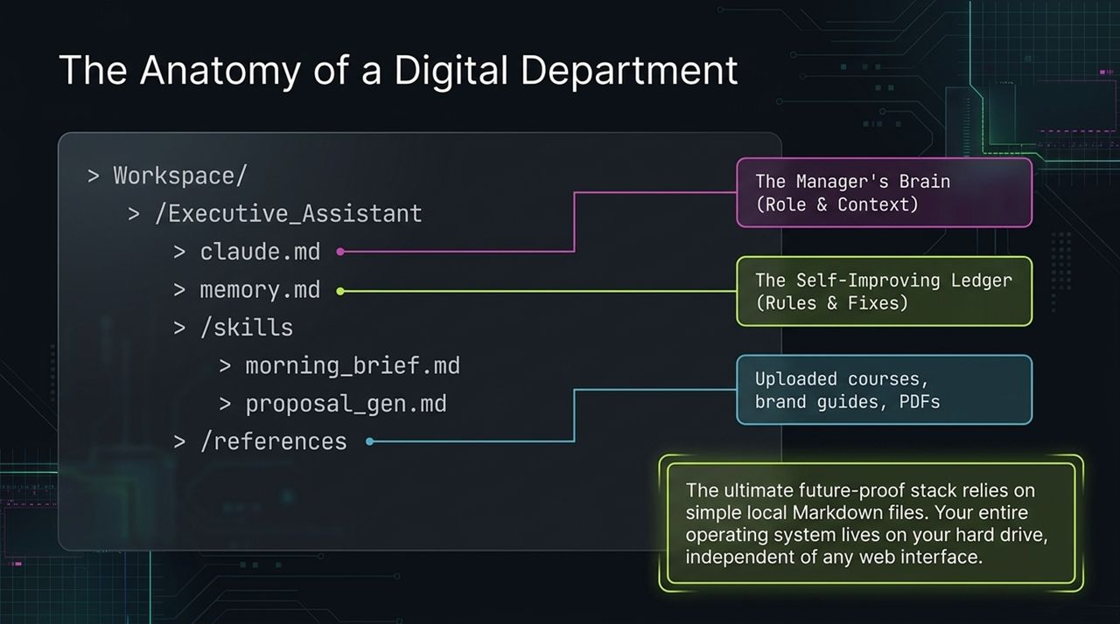
Notes:
Local Infrastructure: Here is what a complete digital department looks like on your computer:
claude.md $→$The Manager's Brain (Role & Context).
memory.md $→$The Self-Improving Ledger (Rules & Fixes).
/skills $→$The SOP Library (Specific Workflows).
/references $→$The Knowledge Vault (Uploaded brand guides, PDFs, books).
Future-Proofing: Your entire operating system lives on your hard drive, completely independent of web UI updates or vendor lock-in.

Slide 12
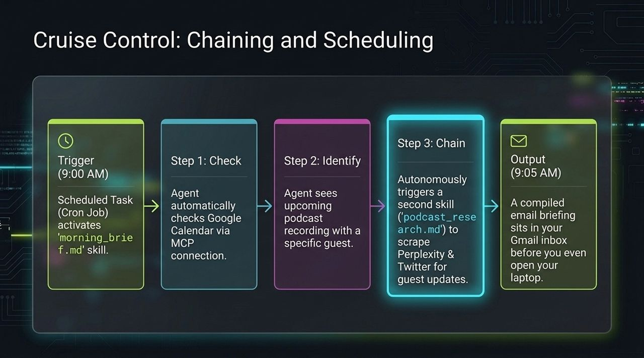
Notes:
Automated Workflow: Combining MCP, skills, and scheduling brings true automation:
Trigger (9:00 AM): A scheduled Cron Job activates morning_brief.md.
Step 1 (Check): Agent checks Google Calendar via MCP.
Step 2 (Identify & Chain): Sees an upcoming podcast guest, autonomously chaining a second skill (podcast_research.md) to research the guest across Twitter and Perplexity.
Output (9:05 AM): A comprehensive brief lands in your inbox before you start work.

Slide 13
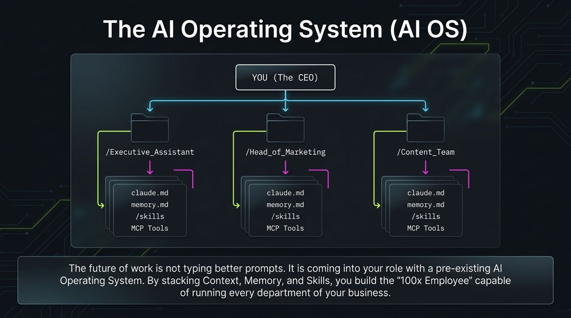
Notes:
Orchestrating Departments: You transition from an individual contributor to the CEO of a digital organization. You manage distinct departments, each equipped with its own context, memory, skill set, and MCP integrations.
The 100x Employee: By stacking Context, Memory, and Skills across departments, you build the '100x Employee' infrastructure capable of executing end-to-end operations seamlessly.

Slide 14
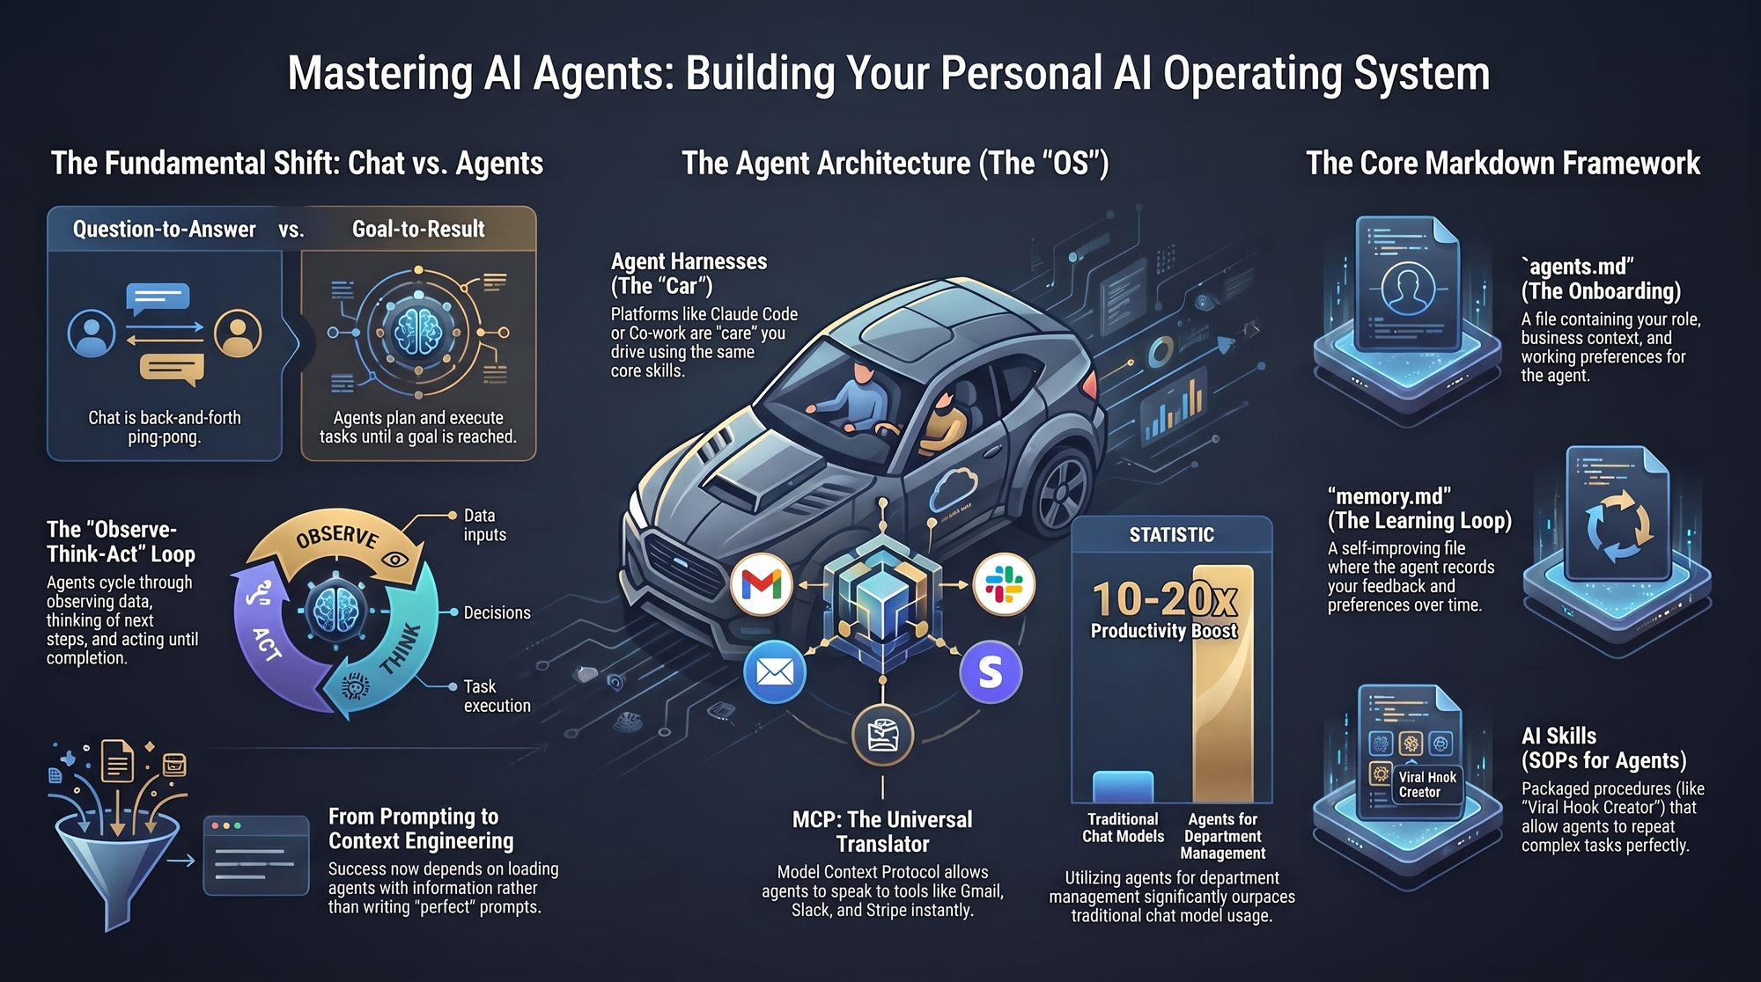
Notes:
Summary Review: To wrap up, let's review the shift:
Framework: We move from chat ping-pong to goal-oriented Observe-Think-Act loops.
Context: We replace long prompt typing with persistent system files (agents.md, memory.md).
Tooling: MCP connects our local Markdown OS to enterprise tools.
Final Call to Action: Start simple: set up your root folder, create your first claude.md context file, log your preferences in memory.md, and turn your first workflow into a reusable skill.
https://www.youtube.com/watch?v=eA9Zf2-qYYM

